Slide 1
Advanced Programming
Lab 04

Slide 2
CONTENTS
Objectives
Knowledge points
Exercises

Slide 3
1 Objectives
Learn to create and use pointers
Learn to manage dynamic memory

Slide 4
2 Knowledge Points
2.1 Pointers
2.2 Dynamic memory management

Slide 5
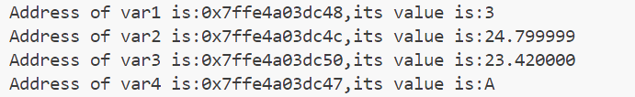
2.1 Pointers
Pointer is a special type who holds the address of value.
#include <stdio.h>
int main()
{
int var1 =3;
float var2 =24.8f;
double var3 =23.42;
char var4 ='A';
printf("Address of var1 is:%p,its value is:%d\n",&var1,var1);
printf("Address of var2 is:%p,its value is:%f\n",&var2,var2);
printf("Address of var3 is:%p,its value is:%1f\n",&var3,var3);
printf("Address of var4 is:%p,its value is:%c\n",&var4,var4);
return 0;
}
%p specifier is for address,and &var1 gives its address, var1 is value.
System uses hexadecimal notation when displaying address values.
Result:

Slide 6
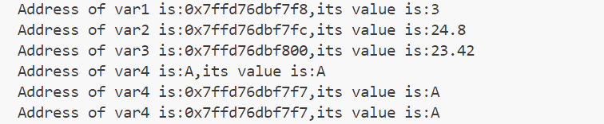
C++ Expression
#include <iostream>
using namespace std;
int main()
{
int var1 =3;
float var2 =24.8f;
double var3 =23.42;
char var4 ='A';
cout <<"Address of var1 is:"<<&var1 <<",its value is:"<<var1 <<endl;
cout <<"Address of var2 is:"<<&var2 <<",its value is:"<<var2 <<endl;
cout <<"Address of var3 is:"<<&var3 <<",its value is:"<<var3 <<endl;
cout <<"Address of var4 is:"<<&var4<<",its value is:"<<var4<<endl;
cout <<"Address of var4 is:"<<(void*)(&var4)<<",its value is:"<<var4<<endl;
cout <<"Address of var4 is:"<<static_cast<void *>(&var4)<<",its value is:"<<var4<<endl;
return 0;
}
If you want to print the address of a character or a string, you need cast the data type explicitly.
Result:

Slide 7
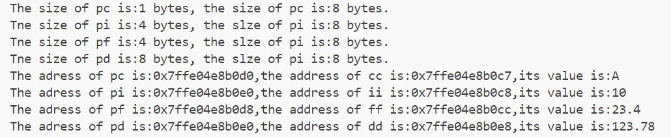
Size and Address of Pointer
#include <iostream>
using namespace std;
int main()
{
char *pc,cc ='A';
int *pi,ii =10;
float *pf,ff =23.4f;
double *pd,dd =123.78;
pc=&cc;
pi =&ii;
pf=&ff;
pd=&dd;
cout << "The size of pc is:" << sizeof(cc) << " bytes, the size of pc is:"<< sizeof(pc) << " bytes." << endl;
cout << "Tne size of pi is:" << sizeof(ii) << " bytes, the slze of pi is:"<< sizeof(pi) << " bytes." << endl;
cout << "Tne size of pf is:" << sizeof(ff) << " bytes, the slze of pi is:"<< sizeof(pf) << " bytes." << endl;
cout << "Tne size of pd is:" << sizeof(dd) << " bytes, the slze of pi is:"<< sizeof(pd) << " bytes." << endl;
cout << "The adress of pc is:" << &pc << ",the address of cc is:" << (void*)pc << ",its value is:" << *pc <<endl;
cout << "The adress of pi is:" << &pd << ",the address of ii is:" << pi << ",its value is:" << *pi <<endl;
cout << "The adress of pf is:" << &pf << ",the address of ff is:" << pf << ",its value is:" << *pf <<endl;
cout << "The adress of pd is:" << &pd << ",the address of dd is:" << pd << ",its value is:" << *pd <<endl;
return 0;
}
Result:
size of pointer
&pd: The address of the pointer pd itself.
pd: The address that pd points to, which is the address of dd.
*pd: The value that pd points to, which is the value of dd, 123.78.

Slide 8
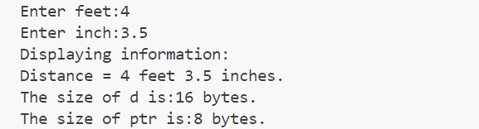
Pointer and structure
#include <iostream>
using namespace std;
struct Distance
{
int feet;
double inch;
};
int main()
{
Distance *ptr,d;
ptr = &d;
cout << "Enter feet:";
cin >> (*ptr).feet;
cout << "Enter inch:";
cin >> ptr->inch;
cout << "Displaying information:" << endl;
cout << "Distance = "<< (*ptr).feet << " feet "<< ptr->inch << " inches." << endl;
cout << "The size of d is:" << sizeof(d) << " bytes." << endl;
cout << "The size of ptr is:" << sizeof(ptr) << " bytes." << endl;
return 0;
}
Result:
size of structure
Note: Since pointer ptr is pointed to variable d , (*ptr).inch ,ptr->inch and d.inch are exact the same.

Slide 9
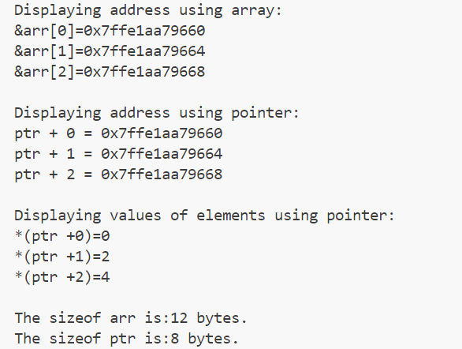
Pointer and array
int main()
{
int size = 3;
float arr[size];
float *ptr;
cout <<"Displaying address using array:"<<endl;
//Access the address of each element by array.
for(int i=0;i<size;i++)
cout <<"&arr["<<i<<"]="<<&arr[i]<<endl;
ptr =arr; //ptr pointes to the array.
cout <<"\nDisplaying address using pointer:"<<endl;
//Access the address of each element by pointer.
for(int i =0;i<size;i++)
cout << "ptr + " << i << " = " << ptr +i << endl;
for(int i=0;i<size;i++)
arr[i]=i*2;
cout << "\nDisplaying values of elements using pointer:" << endl;
//Access the values of elements by pointer using * operator.
for(int i =0;i<size;i++)
cout << "*(ptr +" << i << ")=" << *(ptr +i) << endl;
cout << "\nThe sizeof arr is:" << sizeof(arr) <<" bytes." << endl;
cout << "The sizeof ptr is:" << sizeof(ptr) << " bytes." << endl;
return 0;
}
Result:

Slide 10
Pointer and string
const means the program can not change the string, because the pointer is initialized with constant string or string literal, the const is recommended, otherwise a warning is given when compiling.
#include <iostream>
using namespace std;
int main()
{
const char *msg ="C/C++programming is fun";
const char *copy;
copy =msg;
cout << "msg = " << msg << ",its address is: " << (void*)msg << ",&msg = " << &msg << endl;
cout << "copy= " << copy << ",its address is: " << (void*)copy << ",©= " << &copy << endl;
return 0;
}
Result:
These two values are equal, indicates both of the pointers are pointed to the same string, although their own address are different.

Slide 11



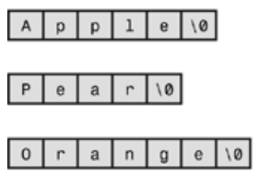
Pointer Array: each element in the array is a pointer.
char fruit1[3][7] = { “Apple”, “Pear”, “Orange”};
fruit1 is an array of three elements, and each of these elements
is itself an array of 7 char values with all the rows of the same
length. In short, fruit1 is an array of arrays of char and is stored
consecutively in memory.
const char *fruit2[3] = { “Apple”, “Pear”, “Orange”};
fruit2 is an array of three pointers-to-char, each element doesn’t
necessarily have to be stored consecutively in memory. It sets up
a ragged array.

Slide 12
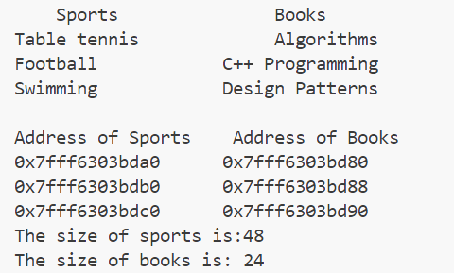
Pointer Array: address and size
#include <iostream>
#include <iomanip>
#include <cstring>
using namespace std;
int main()
{
char sports[3][16]={"Table tennis","Football","Swimming"};
const char *books[3]={"Algorithms","C++ Programming","Design Patterns"};
cout << setw(10) << "Sports" << setw(20) << "Books" << endl;
for(int i=0;i<3;i++)
cout << sports[i] << setw(35 -strlen(sports[i])) << books[i] << endl;
cout << setw(10) << "\nAddress of Sports" << setw(20) << "Address of Books" << endl;
for(int i=0;i<3;i++)
cout << &sports[i] << setw(20) << &books[i] << endl;
cout << "The size of sports is:" << sizeof(sports) << endl;
cout << "The size of books is: " << sizeof(books) << endl;
return 0;
}
Define and initialize an array of pointer
Use index to access the element of the pointer array
Result:

Slide 13
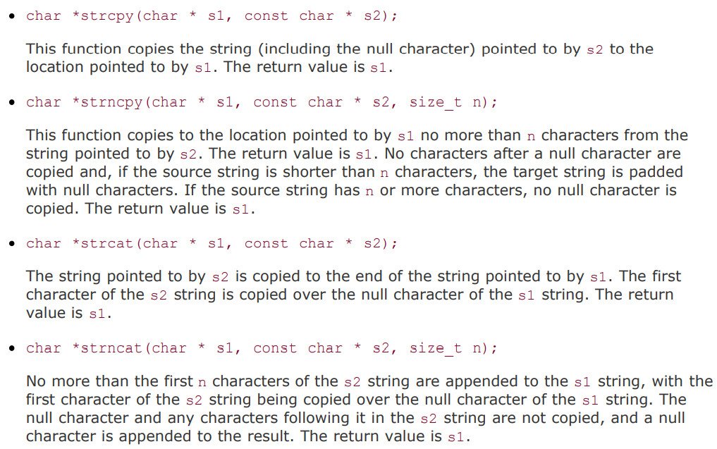
String functions
#include <cstring>
https://en.cppreference.com/w/cpp/header/cstring

Slide 14
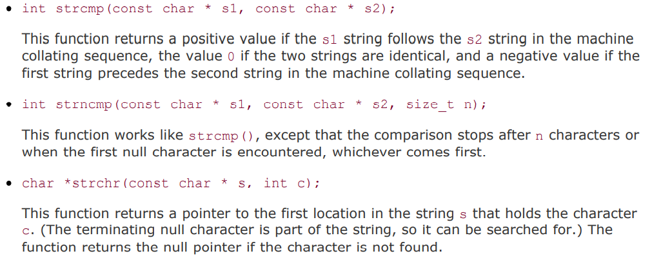
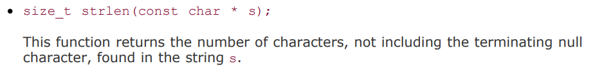
typedef unsigned int size_t;

Slide 15
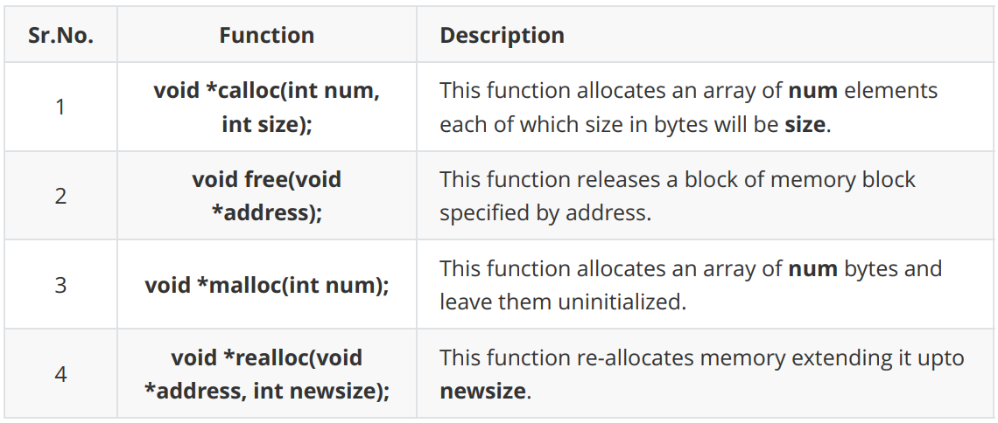
2.2 Dynamic Memory
2.2.1 C Dynamic Memory
These functions can be found in the <stdlib.h> header file.
When you are not in need of memory any more, you should release that memory by calling the function free().

Slide 16
1 Allocating Memory Dynamically
#include <stdio.h>
#include <stdlib.h>
#include<string.h>
int main()
{
char name[100];
char *description;
strcpy(name,"Zara Ali");
/*allocate memory dynamically */
description =(char *)malloc(200*sizeof(char));
if(description ==NULL)
fprintf(stderr,"Error-unable to allocate required memory.\n");
else
strcpy(description,"Zara Ali is a DPS student in class 10.");
printf("Name =%s\n",name);
printf("Description:%s\n",description);
free(description);
return 0;
}
Let the pointer point to the memory, you can use calloc(200, sizeof(char)) to replace malloc function.
Release the memory.
Result:

Slide 17
2 Resizing Memory
#include <stdio.h>
#include <stdlib.h>
#include<string.h>
int main()
{
char name[100];
char *description;
strcpy(name,"Zara Ali");
/*allocate memory dynamically */
description =(char *)malloc(30*sizeof(char));
if(description ==NULL)
fprintf(stderr,"Error-unable to allocate required memory.\n");
else
strcpy(description,"Zara Ali is a DPS student.");
description = (char *) realloc(description, 100*sizeof(char));
if(description ==NULL)
fprintf(stderr,"Error-unable to allocate required memory.\n");
else
strcat(description,"She is in class 10.");
printf("Name =%s\n",name);
printf("Description:%s\n",description);
free(description);
return 0;
}
void *realloc(void *ptr, size_t size);
realloc deallocates the old object pointed to by ptr and returns a pointer to a new object that has the size specified by size. The contents of the new object is identical to that of the old object prior to deallocation, up to the lesser of the new and old sizes. Any bytes in the new object beyond the size of the old object have indeterminate values.
You can increase or decrease the size of an allocated memory block by calling the function realloc().
Result:

Slide 18
2.2.2 C++ Dynamic Memory
1. new and delete Operators
#include <iostream>
using namespace std;
int main()
{
//Pointer initial with null
double *pvalue = NULL;
//Request memory for the variable
pvalue = new double;
//Store value at allocated address
*pvalue = 1294948.98;
cout << "Value of pvalue:" << *pvalue << endl;
//Free up the memory
delete pvalue;
return 0;
}
data-type could be any built-in data type including an array or any user defined data types such as structure or class.
new data-type;
Use new operator to allocate memory dynamically for any data-type.
delete pointer variable;
Use delete operator to de-allocate memory that was previously allocated by new operator.
Result:

Slide 19

2. Dynamic Memory Allocation for Arrays
#include <iostream>
using namespace std;
int main()
{
int *pArray =NULL ,*t ;
pArray =new int [10];
if(pArray ==NULL )
{
cout <<"allocation failure.\n";
exit(0);
}
for(int i =0;i<10;i++)
pArray[i]=100 +i;
cout <<"Displaying the Array Content"<<endl;
for(t =pArray;t<pArray+10;t++)
cout << *t <<" ";
delete []pArray ;
return 0;
}
Allocate the memory to store 10 integers, and assign its address to the pointer pArray.
Assign 10 values to the memory by the pointer pArray.
If you access the value by * operator, be sure do not move the pointer which assign the address by new.
Release the memory.
Result:

Slide 20

Memory Leak
#include<iostream>
using namespace std;
int main()
{
int*pArray =NULL;
pArray =new int[10];
if(pArray ==NULL)
{
cout << "Allocateion failure.\n";
exit(0);
}
for(int i = 0;i < 10;i++)
pArray[i] = 100+i;
cout << "Displaying the Array countents:" << endl;
for(int i=0;i<10;i++,pArray++)
cout << *pArray << " ";
delete[] pArray;
return 0;
}
100
101
102
103
104
105
106
107
108
109
memory leak
内存泄漏
pArray
After for loop, the pointer is now pointed to the memory out of the range you have requested.
Result:

Slide 21
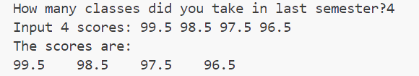
Many times, you are not aware in advance how much memory you will need to store particular information in a defined variable, but the size of required memory can be determined at run time.
#include <iostream>
using namespace std;
int main()
{
int n;
cout << "How many classes did you take in last semester?";
cin >> n;
float *pScore =new float[n];
float *pt =pScore;
cout << "Input " << n << " scores: ";
for(;pt<pScore +n;pt++)
cin >> *pt;
cout << "The scores are:\n";
pt =pt -n;
for(;pt<pScore +n;pt++)
cout << *pt << "\t";
cout << "\n";
delete []pScore;
return 0;
}
Result:

Slide 22
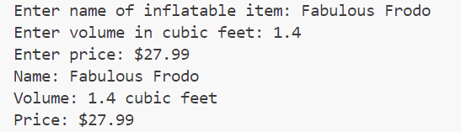
3. Dynamic Memory Allocation for Structures
#include <iostream>
struct inflatable // structure definition
{
char name[20];
float volume;
double price;
};
int main()
{
using namespace std;
inflatable * ps = new inflatable; // allot memory for structure
cout << "Enter name of inflatable item: ";
cin.get(ps->name, 20); // method 1 for member access
cout << "Enter volume in cubic feet: ";
cin >> (*ps).volume; // method 2 for member access
cout << "Enter price: $";
cin >> ps->price;
cout << "Name: " << (*ps).name << endl; // method 2
cout << "Volume: " << ps->volume << " cubic feet\n"; // method 1
cout << "Price: $" << ps->price << endl; // method 1
delete ps; // free memory used by structure
return 0;
}
Result:

Slide 23
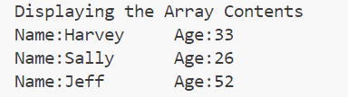
Structured array
#include <iostream>
using namespace std;
struct Employee
{
string Name;
int Age;
};
int main()
{
Employee *DynArray;
DynArray =new(nothrow)Employee[3];
if(DynArray ==NULL){
cout <<"Allocation failure."<<endl;
exit(0);
}
DynArray[0].Name ="Harvey";
DynArray[0].Age =33;
DynArray[1].Name ="Sally";
DynArray[1].Age =26;
DynArray[2].Name ="Jeff";
DynArray[2].Age =52;
cout <<"Displaying the Array Contents"<<endl;
for(int i =0;i<3;i++)
cout <<"Name:"<<DynArray[i].Name <<"\tAge:"<<DynArray[i].Age <<endl;
delete []DynArray;
return 0;
}
Create an unnamed structured array of the Employee type and assign its address to DynArray pointer using new operator
nothrow constant, this constant value is used as an argument for [operator new] and [operator new[]] to indicate that these functions shall not throw an exception on failure, but return a null pointer instead.
Result:

Slide 24
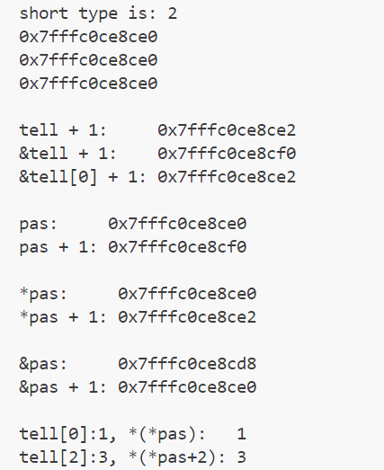
The Address of an Array
#include <iostream>
int main()
{
using namespace std;
short tell[8]={1,2,3}; // tell an array of 16 bytes
cout << "short type is: " << sizeof(short) << endl;
cout << tell << endl; // displays &tell[0]
cout << &tell << endl; // displays address of whole array
cout << &tell[0] << endl; // displays the address of first element
cout << "\ntell + 1: "<< tell + 1 << endl; // move 2 bytes
cout << "&tell + 1: "<< &tell + 1 << endl; // move 16 bytes
cout << "&tell[0] + 1: "<< &tell[0] + 1 << endl;// move 2 bytes
short (*pas)[8] = &tell;
cout << "\npas: "<< pas << endl; // same to address of whole array = &tell
cout << "pas + 1: "<< pas + 1 << endl; // move 16 bytes
cout << "\n*pas: "<< *pas << endl; // same to address of first element = tell
cout << "*pas + 1: "<< *pas + 1<< endl; // move 2 bytes
cout << "\n&pas: "<< &pas << endl;
cout << "&pas + 1: "<< &pas + 1 << endl;
cout << "\ntell[0]:"<< tell[0] <<", *(*pas): "<<*(*pas)<< endl;
cout << "tell[2]:"<< tell[2]<<", *(*pas+2): "<<*(*pas+2) << endl;
return 0;
}
Result:

Slide 25
Exercise 1
Run the program and explain the result to SA.
#include<stdio.h>
int main()
{
int a[]={2,4,6,8,10},y=1,*p;
p=&a[1];
printf("a = %p\np = %p\n",a, p);
for(int i = 0; i < 3; i++)
y += *(p+i);
printf("y = %d\n\n",y);
int b[5]={1,2,3,4,5};
int *ptr=(int*)(&b+1);
printf("b = %p\nb+4 = %p\nptr = %p\n",b,b+4,ptr);
printf("%d,%d\n",*(b+1),*(ptr-1));
return 0;
}

Slide 26
Exercise 2
Run the program and explain the result to SA.
#include <iostream>
using namespace std;
int main()
{
int a[][4]={1,3,5,7,9,11,13,15,17,19};
int *p=*(a+1);
p += 3;
cout << "*p++ = " << *p++ << ",*p = " << *p << endl;
const char *pc = "Welcome to programming.", *r;
long *q = (long *)pc;
q++;
r = (char *)q;
cout << r << endl;
unsigned int m = 0x3E56AF67;
unsigned short *pm = (unsigned short *) &m;
cout << "*pm = " << hex << *pm << endl;
return 0;
}

Slide 27
Exercise 3
Run the program and explain the result to SA.
#include <stdio.h>
int main()
{
int aa[2][5] = { 1,2,3,4,5,6,7,8,9,10 };
int* paa1 = (int*)(&aa + 1);
int* paa2 = (int*)(*(aa + 1));
printf("%d,%d\n", *(paa1 - 1), *(paa2 - 1));
char* str[] = { "work","at","alibaba" };
char** ps = str;
ps++;
printf("%s\n", *ps);
return 0;
}

Slide 28
Exercise 4
Write a program that use new to allocate the array dynamically for five integers.
The five values will be stored in an array using a pointer.
Print the elements of the array in reverse order using a pointer.

